Slide 2
We vote to help us make important choices.
Have you ever made an important choice?

Slide 3
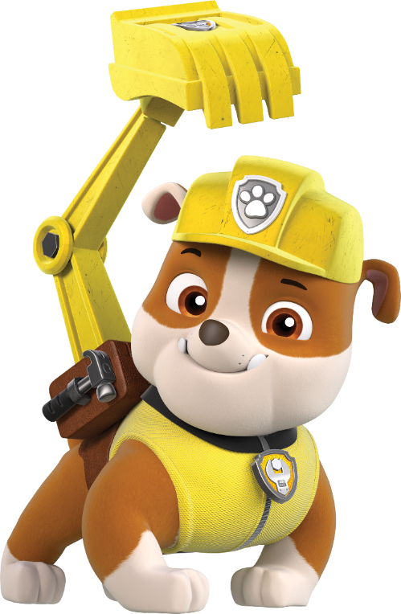
Adults vote to make choices about their community. They vote to make choices about schools, playgrounds, and parks.
Their votes make sure we have great places to play and go to school!

Slide 4
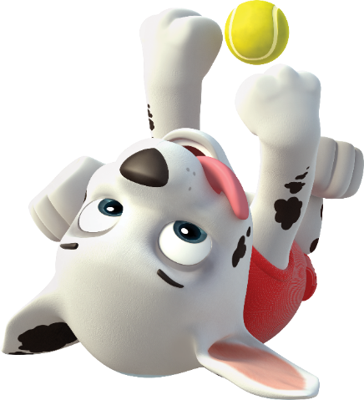
Just like choosing your favorite book, toy, or cookie, it is important to think carefully about your choice when you vote.
What book would you vote for? What cookie would you vote for? What toy would you vote for?

Slide 5
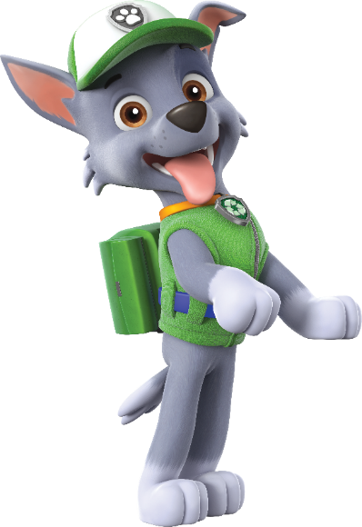
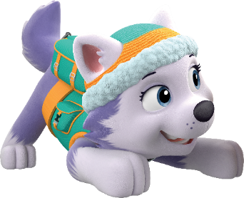
1
Voting makes sure fair choices are made because everyone gets to choose.

Slide 6
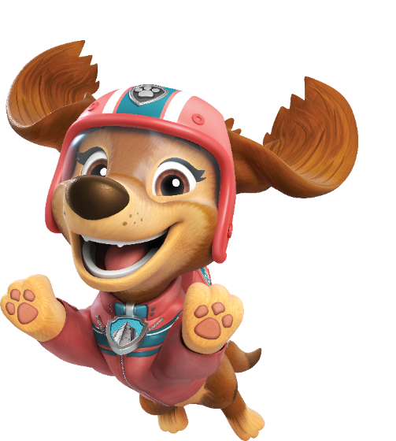
Adults vote on a piece of paper called a ballot or on a computer. It gives them different choices.
Every vote is important.
When you are an adult, you will vote, too!

Slide 7
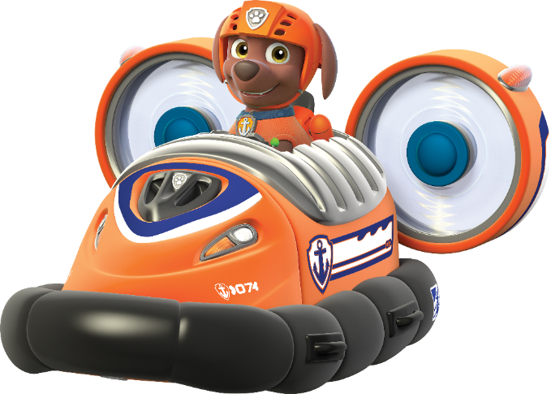
When we vote, we can make things better for our community.
Shall we practice voting?
You can vote for one PAW Patrol pup to be Pup President for our class.

Slide 8
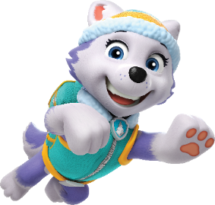
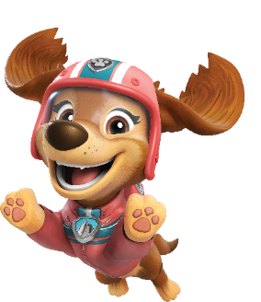
Let’s learn more about each of the pups that you can vote for:
Chase
Everest
Chase is good at guiding others. He is well-organized and can solve problems with his detective skills.
Everest is a team player. She makes sure everyone is safe in the ice and snow.
Liberty
Liberty takes care of others. She always stands up for a community member in need.
Marshall
Marshall is brave. He has lots of energy and is always keen to help.

Slide 9
Rocky
Rubble
Rocky has a big imagination. He is good at repairing and fixing things.
Rubble is kind-hearted. He is a friend who always shares his snacks.
Skye
Skye is daring. She flies high to help those in need.
Zuma
Zuma is an eager pup ready to dive in and save the day.

Slide 10
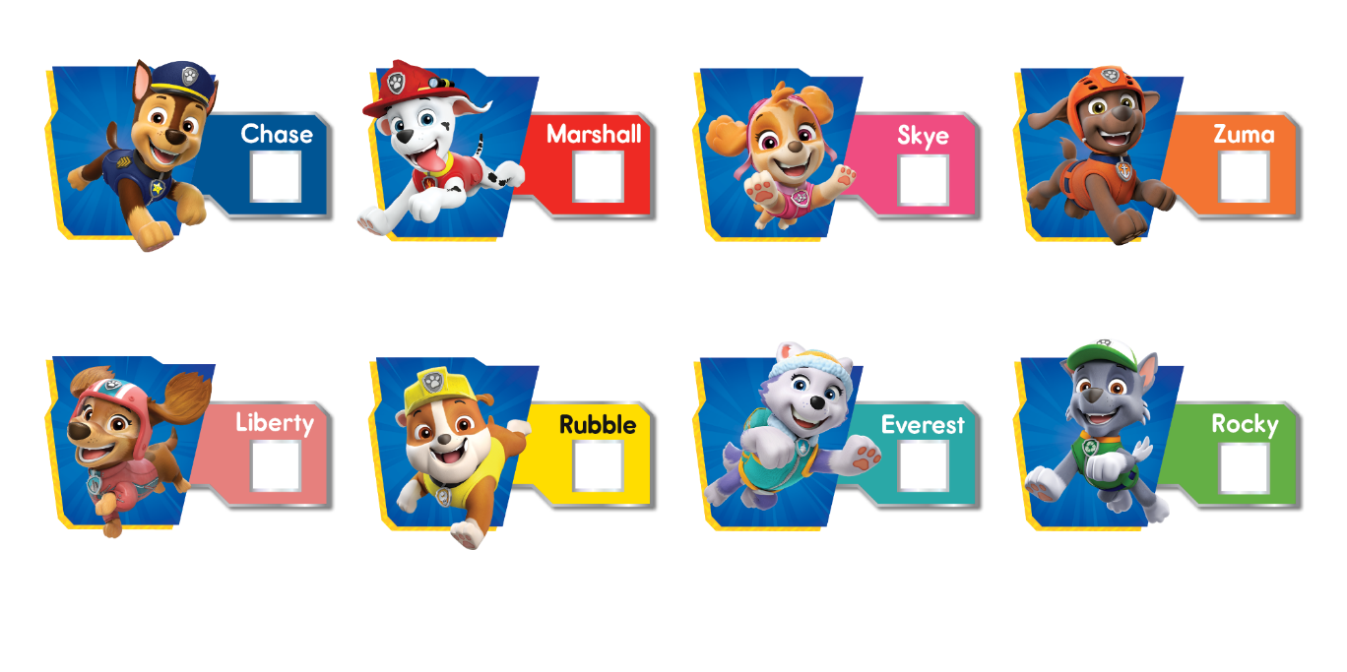
Which PAW Patrol pup would you vote for to be Pup President for our class?
The pup with the most votes wins!

Slide 11
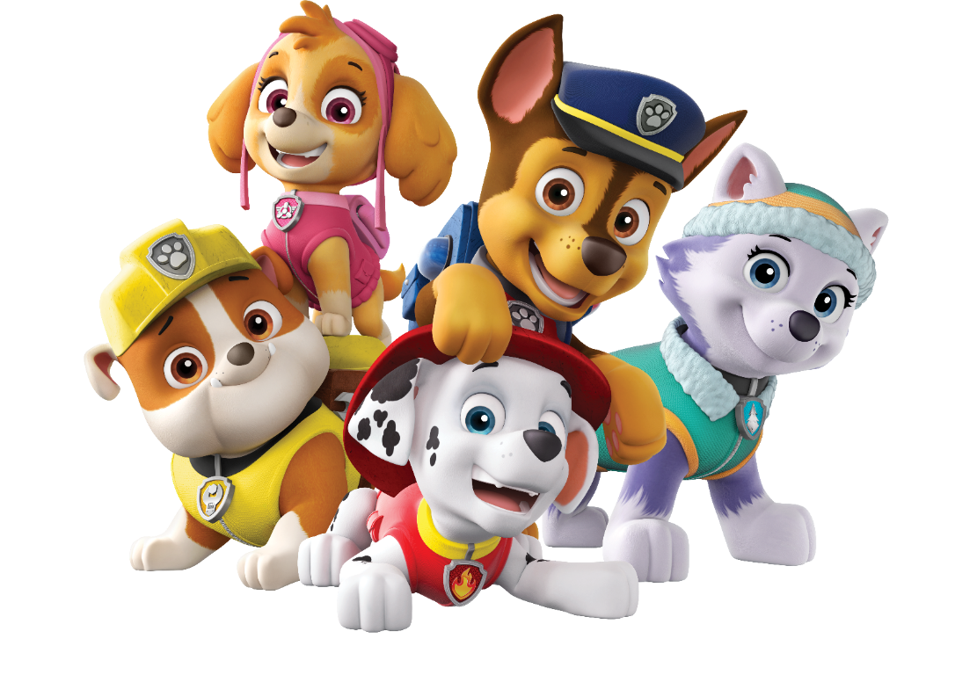
Our new PAW Patrol Class Pup President is…

